Slide 1
Challenges facing EUCAST implementation in the laboratory focusing on phenotypic testing
Marshagne Smith
SASCM EUCAST Implementation Workshop
26 May 2016

Slide 2
www.eucast.org

Slide 4
Media
Technique
Temperature
Discs
Inoculum
Time

Slide 6
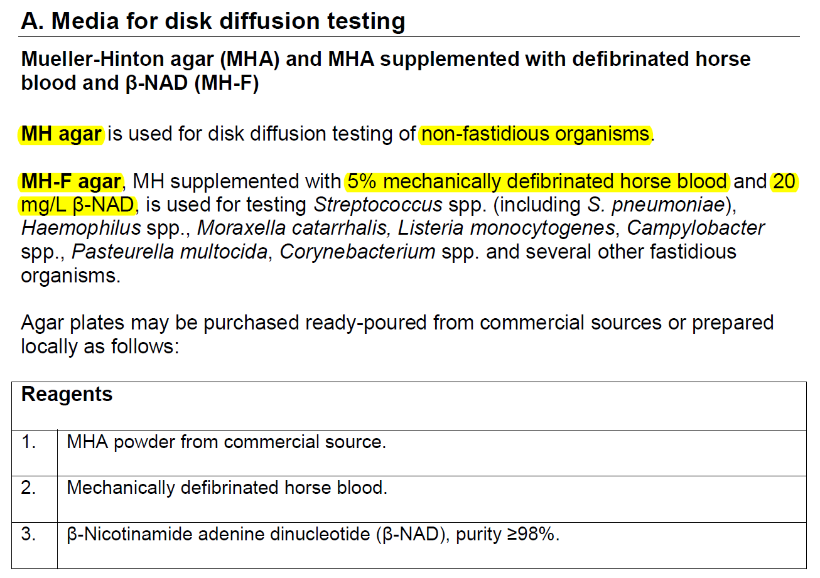

Slide 7
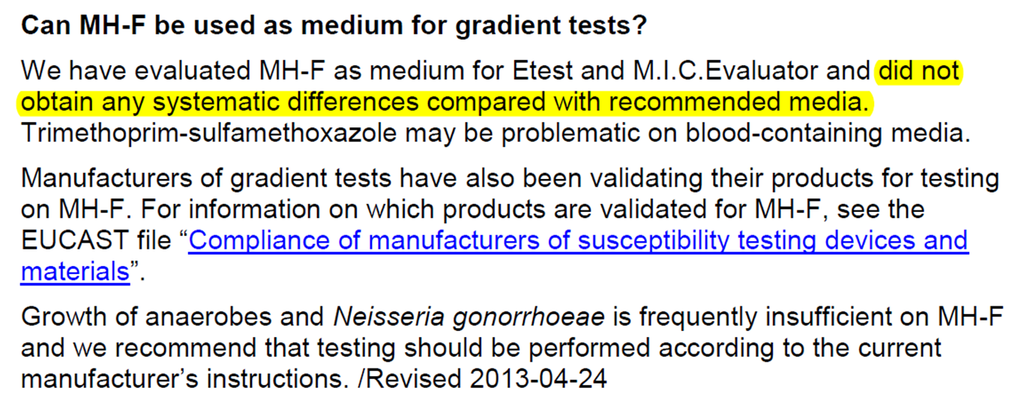
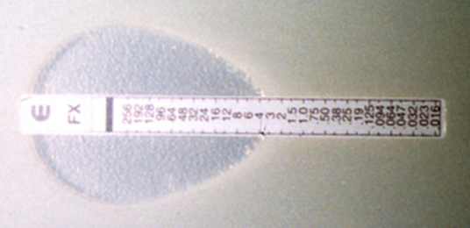
EUCAST DISC DIFFUSION TEST-MEDIUM

Slide 9
Makes about 625 plates

Slide 10
“if it defibrinated blood that you need, it is much more expensive than the normal anti-coagulated blood”
Comments from a media producer
“I just spoke to our supplier and he says yes you do get defibrinated whole blood, but the procedure is too expensive for them so they do not supply it”

Slide 12
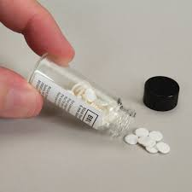
EUCAST DISK DIFFUSION TEST - DISKS
Cefotaxime
Ceftazidime
Colistin
Netilmicin
Nitrofurantoin
Piperacillin
Pip-Taz
Fosfomycin
Netilmicin
Among others….

Slide 16
EUCAST DISK DIFFUSION-QUALITY CONTROL

Slide 17
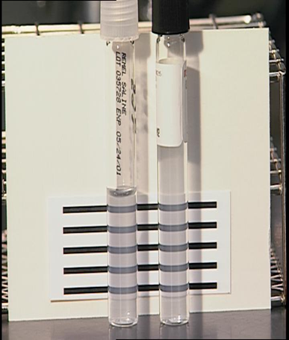
EUCAST DISK DIFFUSION TEST - INOCULUM

Slide 22
EUCAST DISK DIFFUSION TEST-READING

Slide 24
EUCAST DISK DIFFUSION TEST-OTHER

Slide 26
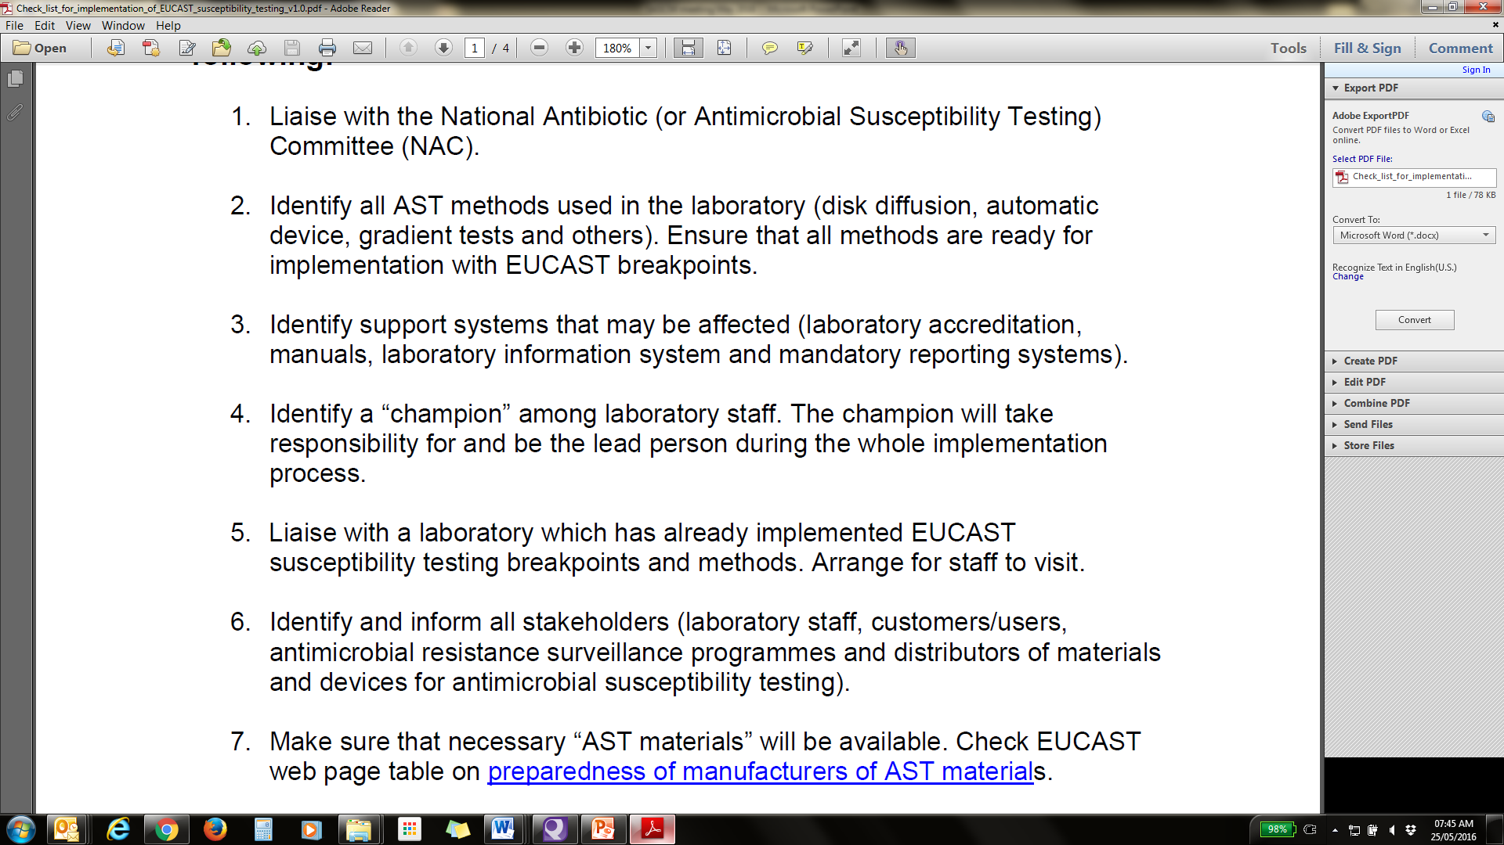

Slide 27
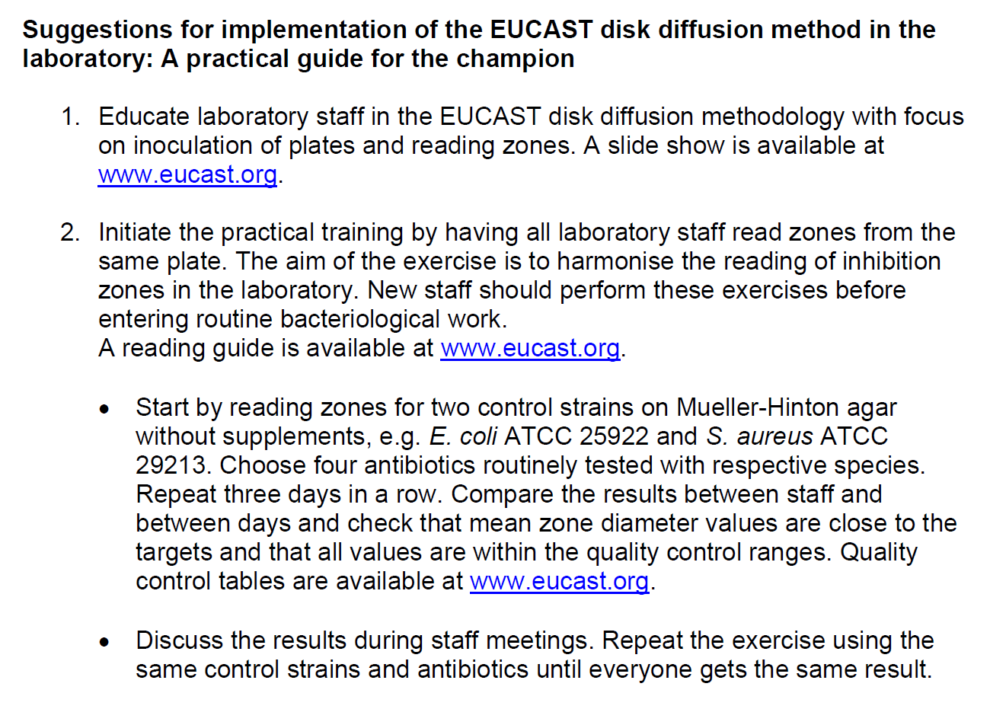

Slide 28
Major considerations
1. Production and cost of the MH-F medium
2. Sourcing and procurement of discs with different concentrations
3. Validation of media and discs
4. Updating of SOP’s
5. Training and re training of staff

Slide 29
Thank you for your attention!!

